Slide 1
Introduction to Tools and Platforms

Slide 2

Describe the concept of Docker and container to streamline application development, deployment, and scaling
Gain an insight into Kubeflow and its architecture for end-to-end ML workflows on Kubernetes
Identify the role of MLflow in managing the machine learning lifecycle

Slide 3
Basics of Docker, Kubernetes, and Kubeflow

Slide 4
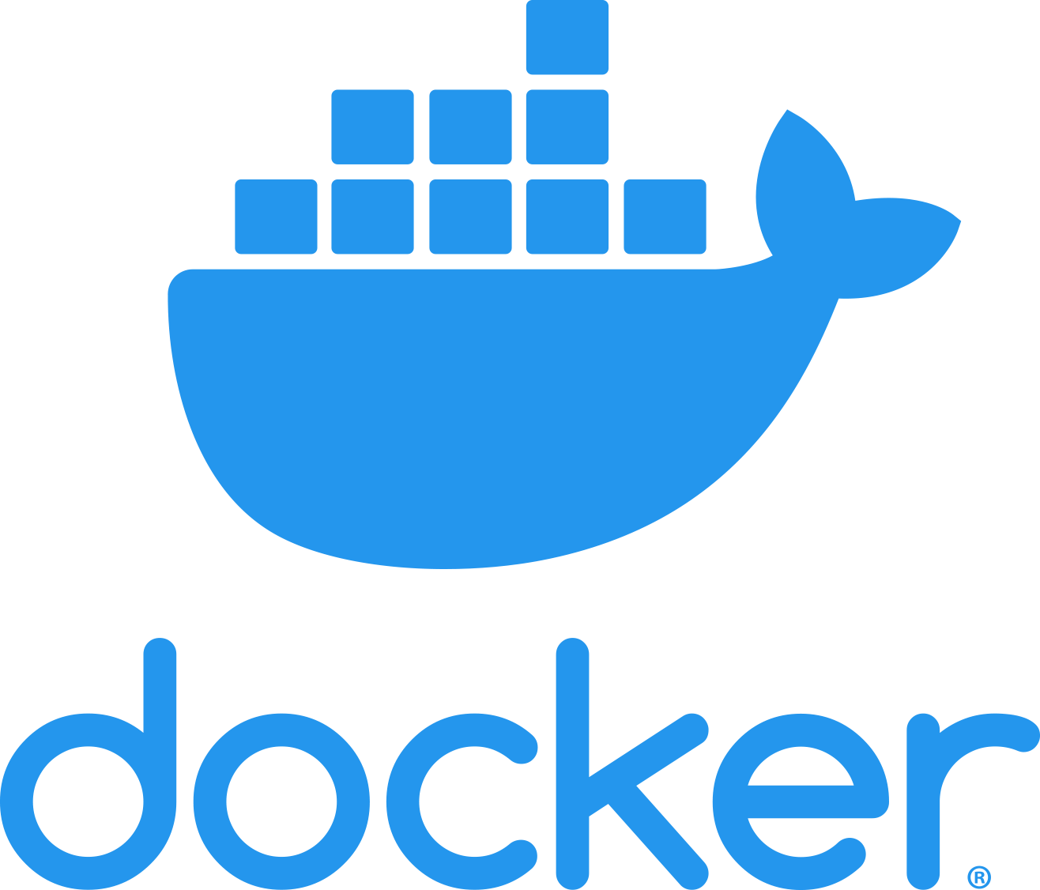
What Is Docker?
It is a platform for developers and sysadmins to develop, ship, and run applications by using containers.
Helps the user to quickly assemble applications from their components and eliminates friction during code shipping
Aids the user to test and deploy the code into production
A container is a lightweight, self-contained, runnable bundle of software that encompasses all the required components like libraries, configuration files, dependencies, and other essentials to run the application.
Notes:
Docker is a platform for developers and sysadmins to develop, ship, and run applications by using containers.
Docker helps the user to quickly assemble applications from its components and eliminates the friction during code shipping.
Docker aids the user to test and deploy the code into production.

Slide 5
Docker Containers Vs. Virtual Machines
Docker containers exhibit greater efficiency compared to VMs, boasting reduced size and resource demands, resulting in enhanced speed.
When faced with the necessity for numerous isolated environments to accommodate multiple applications, generating numerous Docker containers is feasible, unlike VMs constrained by infrastructure prerequisites.
The swift deployment of Docker containers onto servers is feasible due to their lightweight nature, enabling quick start-up and shutdown, a notable contrast to virtual machines.
Notes:
Docker containers are much smaller than VMs and require far fewer resources, which makes them fast.
If we need too many isolated environments to run multiple applications, we can create multiple Docker Containers (let’s say 20 or 30), but we can not create that many VMs due to infrastructure requirements.
Additionally, Docker containers can be easily deployed in servers since containers being lightweight can be started and stopped in very less time compared to virtual machines.

Slide 6

Kubernetes
It is a collection of building components that work together to offer mechanisms for deploying, maintaining, and scaling applications.
The platform gains control over computing and storage resources by defining resources.
Kubernetes is coupled and expanded to handle a variety of workloads and scheduling scenarios.
Notes:
Explain about Kubernetes as mentioned in the above slide.

Slide 7
Kubernetes Architecture
It consists of a master (control plane), a distributed storage system (etcd) for maintaining cluster state consistency, and several cluster nodes.
Master
Controller manager
Developer or operator
API server
Users
scheduler
etcd
Kubelet
cAdvisor
Kube-proxy
Kubelet
cAdvisor
Kube-proxy
….
Pod
Pod
Pod
Pod
Pod
Pod
Plugin network
Node
Node
Notes:
Explain the Kubernetes Architecture.
Kubernetes itself follows a client-server architecture, with a master node composed of etcd cluster, kube-apiserver, kube-controller-manager, cloud-controller-manager, scheduler. Client (worker) nodes are composed of kube-proxy and kubelet components. Core concepts in Kubernetes include Pods (a group of containers deployed together), services (a group of logical Pods with a stable IP address) and deployments (a definition of the desired state for a Pod or replica set, acted upon by a controller if the current state differs from the desired state), among others.

Slide 8

Kubeflow
It is a Kubernetes-native platform for developing, orchestrating, deploying, and running scalable and portable machine learning workloads.
It was created to make it easier for machine learning teams to deploy their models and experiments in a scalable, consistent manner across multiple platforms.
It offers a collection of cloud-native tools for different stages of an ML workflow, from data ingestion and preprocessing to model training and serving, all orchestrated with pipelines.
It also provides a user-friendly UI for managing and tracking experiments, jobs, and runs.
Notes:
Kubeflow is a Kubernetes-native platform for developing, orchestrating, deploying, and running scalable and portable machine learning workloads. It was created to make it easier for machine learning teams to deploy their models and experiments in a scalable, consistent manner across multiple platforms.
Kubeflow offers a collection of cloud-native tools for different stages of an ML workflow—from data ingestion and preprocessing to model training and serving, all orchestrated with pipelines.
It also provides a user-friendly UI for managing and tracking experiments, jobs, and runs. The UI also includes support for collaborative and interactive training with Jupyter notebooks.
Consider a machine learning model that has been developed in a Jupyter notebook on a data scientist's local machine. The model needs to be trained on a large dataset, which requires more computational resources. Kubeflow can be used to easily deploy the model on a Kubernetes cluster, leveraging the power of distributed computing.

Slide 9
Kubeflow Architecture
The UI also includes support for collaborative and interactive training with Jupyter notebooks.
It is designed to leverage the Kubernetes principles of declarative configuration and extensibility.
It consists of operators for various ML frameworks, a UI for managing models and tracking experiments, and components for running machine learning workflows.
This service orchestration engine, Kubernetes, is at the core of Kubeflow, which schedules and scales all the services.
Notes:
Kubeflow is designed to leverage the Kubernetes principle of declarative configuration and extensibility.
It consists of operators for various ML frameworks, a UI for managing models and tracking experiments, and components for running machine learning workflows.
This service orchestration engine, Kubernetes, is at the core of Kubeflow, which schedules and scales all the services.

Slide 10
Kubeflow Workflows and Components
Kubeflow pipelines
Provides a platform for building, deploying, and managing multi-step ML workflows
KFServing
Provides a Kubernetes custom resource definition for serving machine learning models on arbitrary frameworks
Katib
Helps automate the process of optimizing the hyperparameters in
machine learning models
Notebooks
Helps to combine code execution, text, and visualization
Notes:
Kubeflow Pipelines: Kubeflow Pipelines are a core component of Kubeflow that provides a platform for building, deploying, and managing multi-step ML workflows. This component helps in creating and sharing experiments, orchestrating complex workflows, tracking results, and making it easy to reproduce and automate pipelines.
KFServing: KFServing provides a Kubernetes Custom Resource Definition for serving machine learning models on arbitrary frameworks. It aims to solve production model serving use cases by providing performant, high abstraction interfaces for common ML frameworks like Tensorflow, XGBoost, and PyTorch.
Katib: Katib is a Kubeflow component for hyperparameter tuning and neural architecture search. Katib helps in automating the process of optimizing the hyperparameters in machine learning models.
Notebooks: Notebooks are a set of tools for developing interactive environments where you can combine code execution, text, and visualization. Jupyter notebooks are fully integrated into Kubeflow and provide full control over the lifecycle of your workloads.

Slide 11
Kubeflow Workflows and Components
Central dashboards
Provides a UI for managing all the Kubeflow resources and helps navigate between the Kubeflow components
Metadata
Provides a way to record and retrieve metadata associated with workflows, datasets, artifacts, and executions
Training operators
Allows developers to run distributed training jobs on Kubernetes
Multi-tenancy
Enables multiple people to securely share the same Kubeflow deployment
Notes:
Central Dashboard: The Central Dashboard provides a UI for managing all your Kubeflow resources and helps in navigating between the Kubeflow components.
Metadata: The Metadata component of Kubeflow provides a way to record and retrieve metadata associated with workflows, datasets, artifacts, and executions, which helps in managing and comparing your ML tasks.
Training Operators: Training operators allow developers to run distributed training jobs on Kubernetes. Kubeflow currently includes operators for TensorFlow and PyTorch.
Multi-Tenancy: Kubeflow has been designed from the start to support multi-tenancy, which means multiple people can securely share the same Kubeflow deployment.

Slide 12

Kubeflow Workflows and Components
Experimental phase
With Kubeflow
Iterate tuning
and training
Identify problem
and collect and
analyzes data
Choose an ML
algorithm and
code the model
Experiment with
data and model
training
Tune the model
hyperparameters
PyTorch
Jupyter Notebook
Katib
Scikit-learn
Fairing
TensorFlow
Pipelines
XGBoost
Production phase
With Kubeflow
Iterate tuning
and training
Serve the model
for online or batch
prediction
Monitor the
model’s
performance
Transform data
Train model
Chainer
KFServing
Metadata
MPI
NVIDIA TensorRT
Tensor Board
MXNet
PyTorch
PyTorch
TFServing
TFJob
Seldon
Pipelines
Notes:
The diagram adds Kubeflow to the workflow, showing which Kubeflow components are useful at each stage

Slide 13
Introduction to MLflow

Slide 14

Introduction
MLflow is an open-source platform designed to manage the whole machine learning lifecycle.
It includes experimentation, reproducibility, deployment, and a central model registry.
Its primary purpose is to simplify the process from data exploration to a production-ready model.
Notes:
MLflow as an open-source platform designed to manage the whole machine learning lifecycle. It includes experimentation, reproducibility, and deployment, along with a central model registry.
MLflow's primary purpose is to simplify the process of going from data exploration to a production-ready model.

Slide 15
MLflow: Benefits
Open source
Integration with multiple tools
Experiment tracking
Multi-language support
Modularity
Deployment ease
Model registry
Scalability
Reproducibility
Notes:
Benefits:
Open Source: MLflow is an open-source project. This allows developers and data scientists to contribute to its growth and improvements, ensuring that it stays up-to-date with the latest demands and changes in the machine learning field.
Modularity: MLflow is composed of four main components: MLflow Tracking, MLflow Projects, MLflow Models, and MLflow Registry. Each of these components can be used independently, which allows you to choose only what you need without having to adopt the entire system.
Integration with Multiple Tools: MLflow is designed to work with many existing machine learning tools and libraries, such as TensorFlow, PyTorch, Sci-kit Learn, etc. This ensures that you can leverage MLflow’s features without changing your existing workflows and tools.
Reproducibility: MLflow Projects and MLflow Models help to package the code in a reusable and reproducible form. It helps capture data transformations, parameters, algorithms, and more, which aids in replicating results and sharing findings.
Experiment Tracking: With MLflow Tracking, you can log and compare experiments' details, including parameters, metrics, and results. This helps keep track of a vast number of experiments and results, leading to more efficient model selection and development.
Model Registry: MLflow’s Model Registry component allows for collaborative model lifecycle management. Data scientists can share, collaborate, and govern models in a central model store. It makes it easy to transition between model stages (staging, production, etc.), providing a structured model lifecycle.
Multi-language Support: MLflow supports various programming languages, including Python, R, and Java, for experiment tracking, project execution, and model serving. This gives the user the flexibility to work in their preferred language.
Scalability: Since MLflow uses REST APIs and simple data formats, it can be scaled to support large machine learning teams and even machine learning workflows across entire organizations.
Deployment Ease: MLflow makes it easy to deploy machine learning models to various production environments, including cloud-based platforms and on-premise servers, because it abstracts away many of the complexities of model deployment.
By managing the end-to-end machine learning lifecycle, MLflow allows organizations to develop machine learning solutions faster and more efficiently.
MLflow's robust community and extensive ecosystem, which includes integration with popular tools like PyTorch, TensorFlow, Scikit-Learn, and more

Slide 16
MLflow: Components
This component is an API and UI for logging parameters, code versions,
metrics, and output files during ML model training and later visualizing and comparing the results.
MLflow tracking
These are standard formats for organizing and describing the code to let other data scientists or automated tools run it.
MLflow projects
It is a centralized model store, set of APIs, and UI to collaboratively manage the full lifecycle of an MLflow model.
Model registry
They are a way of packaging models to allow various deployment tools to
use them. This can be local or cloud-based, like Microsoft Azure ML or Amazon SageMaker.
MLflow models
Notes:
Components:
MLflow Tracking: This component is an API and UI for logging parameters, code versions, metrics, and output files during ML model training and later visualizing and comparing the results. For example, when training a machine learning model, you can use MLflow Tracking to record information like the learning rate, the number of layers in a neural network, and the accuracy of each training epoch.
MLflow Models: A model can be any artifact that takes input data and produces predictions. MLflow Models offer a convention to help save models from various tools in different flavors (Python function, Hadoop model, etc.). They are a way of packaging models to allow various deployment tools to use them – this can be local or cloud-based like Microsoft Azure ML or Amazon SageMaker.
MLflow Projects: Projects are a standard format for organizing and describing your code to let other data scientists or automated tools run it. Each project is a self-contained set of code files, environment configuration, and runnable tasks. This component assists in sharing reproducible ML code. An example project could contain a Python script to train a Spark MLlib model, packaged with a conda environment configuration.
Model Registry: The MLflow Model Registry is a centralized model store, set of APIs, and UI, to collaboratively manage the full lifecycle of an MLflow Model. It provides model lineage (which MLflow experiment and run produced the model), model versioning, stage transitions (for example from staging to production or archived), and annotations.

Slide 17
Docker containers exhibit greater efficiency compared to VMs, boasting reduced size and resource demands, resulting in enhanced speed.
Kubeflow is a platform designed to run end-to-end ML workflows on Kubernetes, consisting of components such as Kubeflow pipelines, KFServing, Katib, metadata, and notebook servers.
MLflow is an open-source platform that helps manage the end-to-end machine learning lifecycle, including experimentation, reproducibility, and deployment, with components like MLflow tracking, models, projects, and a model registry.

Slide 19
Which component of Kubeflow is responsible for hyperparameter tuning?
1
Kubeflow pipelines
KFServing
Katib
Central dashboard

Slide 20
Which component of Kubeflow is responsible for hyperparameter tuning?
1
Kubeflow pipelines
KFServing
Katib
Central dashboard
C
Katib provides a framework for executing and managing hyperparameter tuning experiments.

Slide 21
What does the metadata component in Kubeflow do?
2
It provides a UI for managing all Kubeflow resources.
It provides a platform for building, deploying, and managing multi-step ML workflows.
It records and retrieves metadata associated with workflows, datasets, artifacts, and executions.
It provides a Kubernetes custom resource definition for serving ML models.

Slide 22
What does the metadata component in Kubeflow do?
2
It provides a UI for managing all Kubeflow resources.
It provides a platform for building, deploying, and managing multi-step ML workflows.
It records and retrieves metadata associated with workflows, datasets, artifacts, and executions.
It provides a Kubernetes custom resource definition for serving ML models.
C
It records and retrieves metadata for tracking and managing machine learning workflows, datasets, and artifacts.

Slide 23
What is the main purpose of the MLflow model registry?
3
To track the performance of different models
To serve models for real-time prediction
To manage the full lifecycle of an MLflow model, providing model versioning, stage transitions, and annotations
To experiment with different machine learning models

Slide 24
What is the main purpose of the MLflow model registry?
3
To track the performance of different models
To serve models for real-time prediction
To manage the full lifecycle of an MLflow model, providing model versioning, stage transitions, and annotations
To experiment with different machine learning models
C
The purpose of the MLflow model registry is to manage the end-to-end lifecycle of MLflow models, including versioning, stage transitions, and annotations.

